Slide 1
Module 2: Mechanical Separations (Chapter 29)
Lecture 7
Somak Chatterjee

Slide 2
Principles of Clarifying Filters, Crossflow Filters and Membrane Filters. Concentration polarization, Sedimentation Process

Slide 3
Principles of Clarifying Filters, Crossflow Filters and Membrane Filters. Concentration polarization

Slide 4
Clarifying Filters
Clarifying filters remove small amounts of solids or liquid droplets from either liquids or gases.
The particles are caught by surface forces and immobilized on the surfaces or within the flow channels. They reduce the effective diameter of the channels but usually do not block them completely.
Clarification differs from screening in that pores in the filter medium are larger-sometimes much larger-than the particles to be removed.

Slide 5
Clarifying Filters
Liquid Clarification
Clarifying filters for liquids include the gravity-bed filters for water treatment
Cake filters are used extensively for clarification.
In Batch units, filtration rate and filtration efficiency are constant for a long period.
Eventually reaches “Breakthrough” value and backwashing or replacement is necessary.
Gas Cleaning
Filters for gas cleaning include pad filters for atmospheric dust and granular beds and bag filters for process dusts.
Air is cleaned by passing it through pads of cellulose pulp, cotton, felt, glass fiber, or metal screening.
The pad material may be dry or coated with a viscous oil to act as a dust holder.

Slide 6
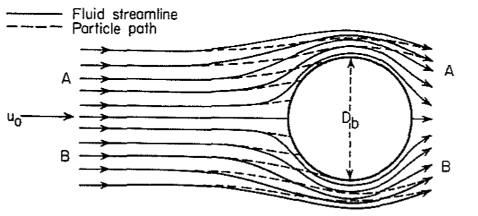
Principles of Clarification
Direct Sieving
The solid particles being removed completely plug the pores of the filter medium and the rate of plugging is constant with time
Standard Blocking
The particles partially block the pores, giving a gradual reduction in pore size
Impingement
In cleaning gases, the separation is by impingement of the particles against a solid surface placed in the flowing stream.
The particles, because of their inertia, are expected to cross the streamlines of the fluid and strike and adhere to the solid, from which they can subsequently be removed.

Slide 7
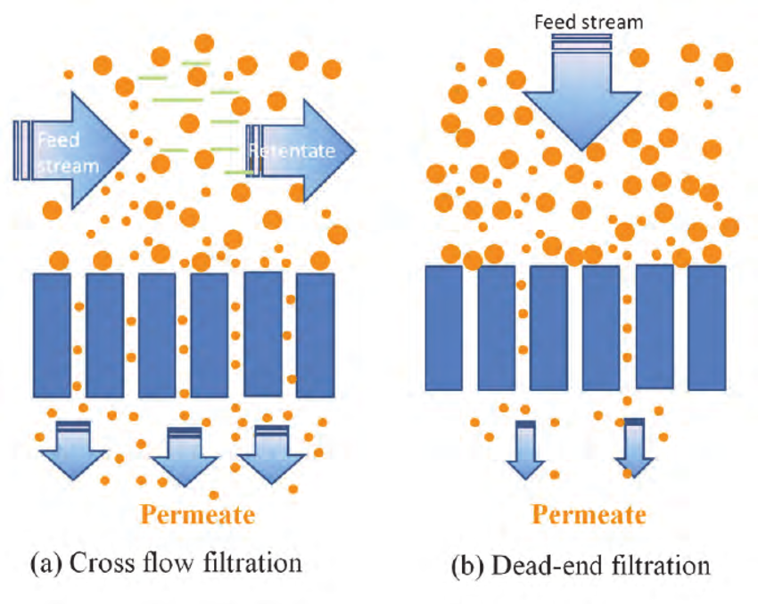
Cross Flow Filtration
Feed is passed through a membrane/bed, the solids being trapped in the filter and the filtrate being released at the other end
Majority of the feed flow travels tangentially across the surface of the filter, rather than into the filter
Principal advantage is that the filter cake is substantially washed away during the filtration process, increasing the length of time that a filter unit can be operational
Applied to concentrate suspension of fine particles or colloidal particles
El–Safty, S. A., & Hoa, N. D. (2012). Organic–Inorganic Mesoporous Silica Nanotube Hybrid Anodic Alumina Membranes for Ultrafine Filtration of Noble Metal Nanoparticles. In Noble Metals. IntechOpen.

Slide 8
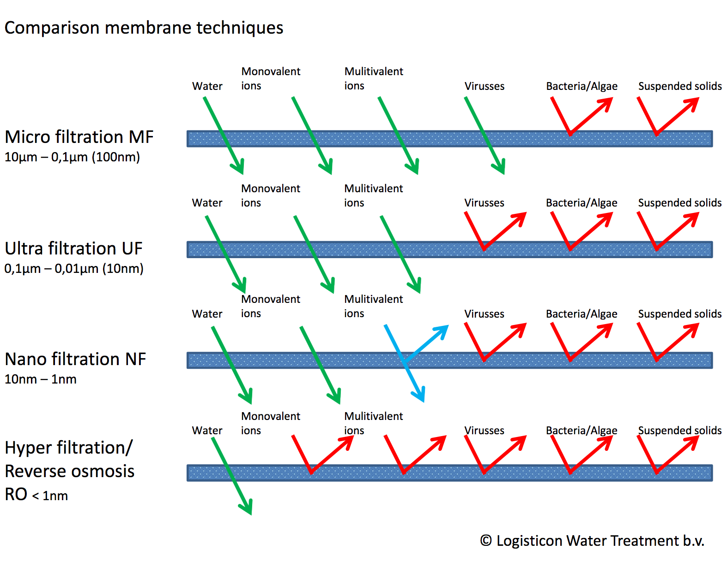
Membrane Filters
Types of Membranes
Polymer membranes (Cellulose Acetate, polyacrylonitrile, polysulfone, polyether sulfone, polyamide, etc.,)
Metallic Membranes (sintered stainless steel or other metals)
Inorganic membranes (Porous carbon or alumina)
https://www.logisticon.com/en/technologies/membrane-filtration/

Slide 9
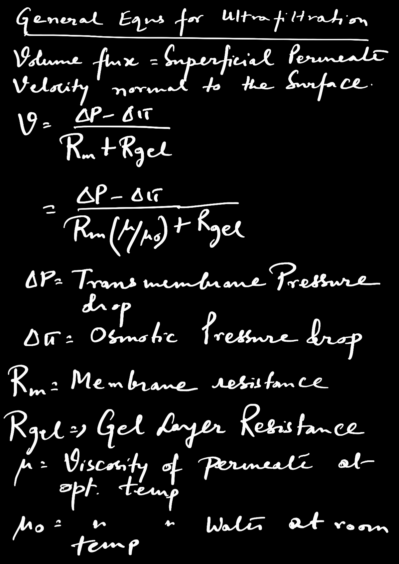


Slide 10
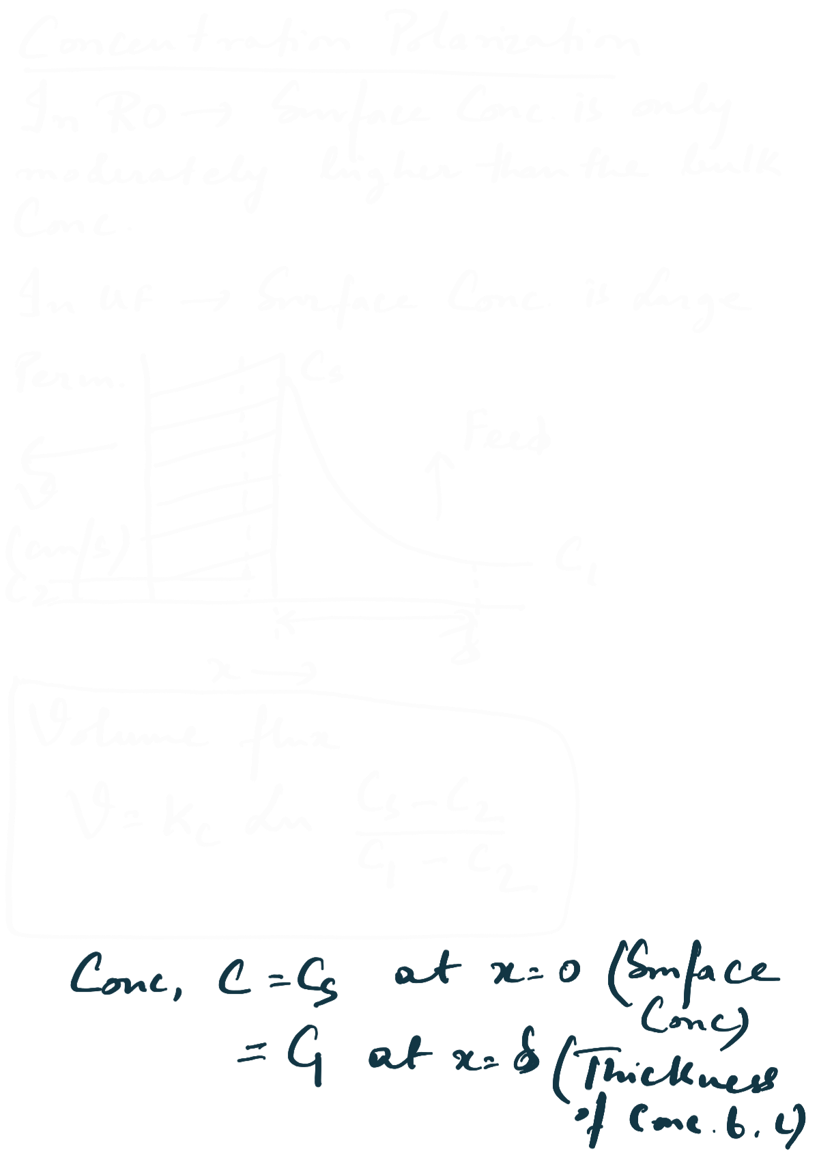

Slide 11
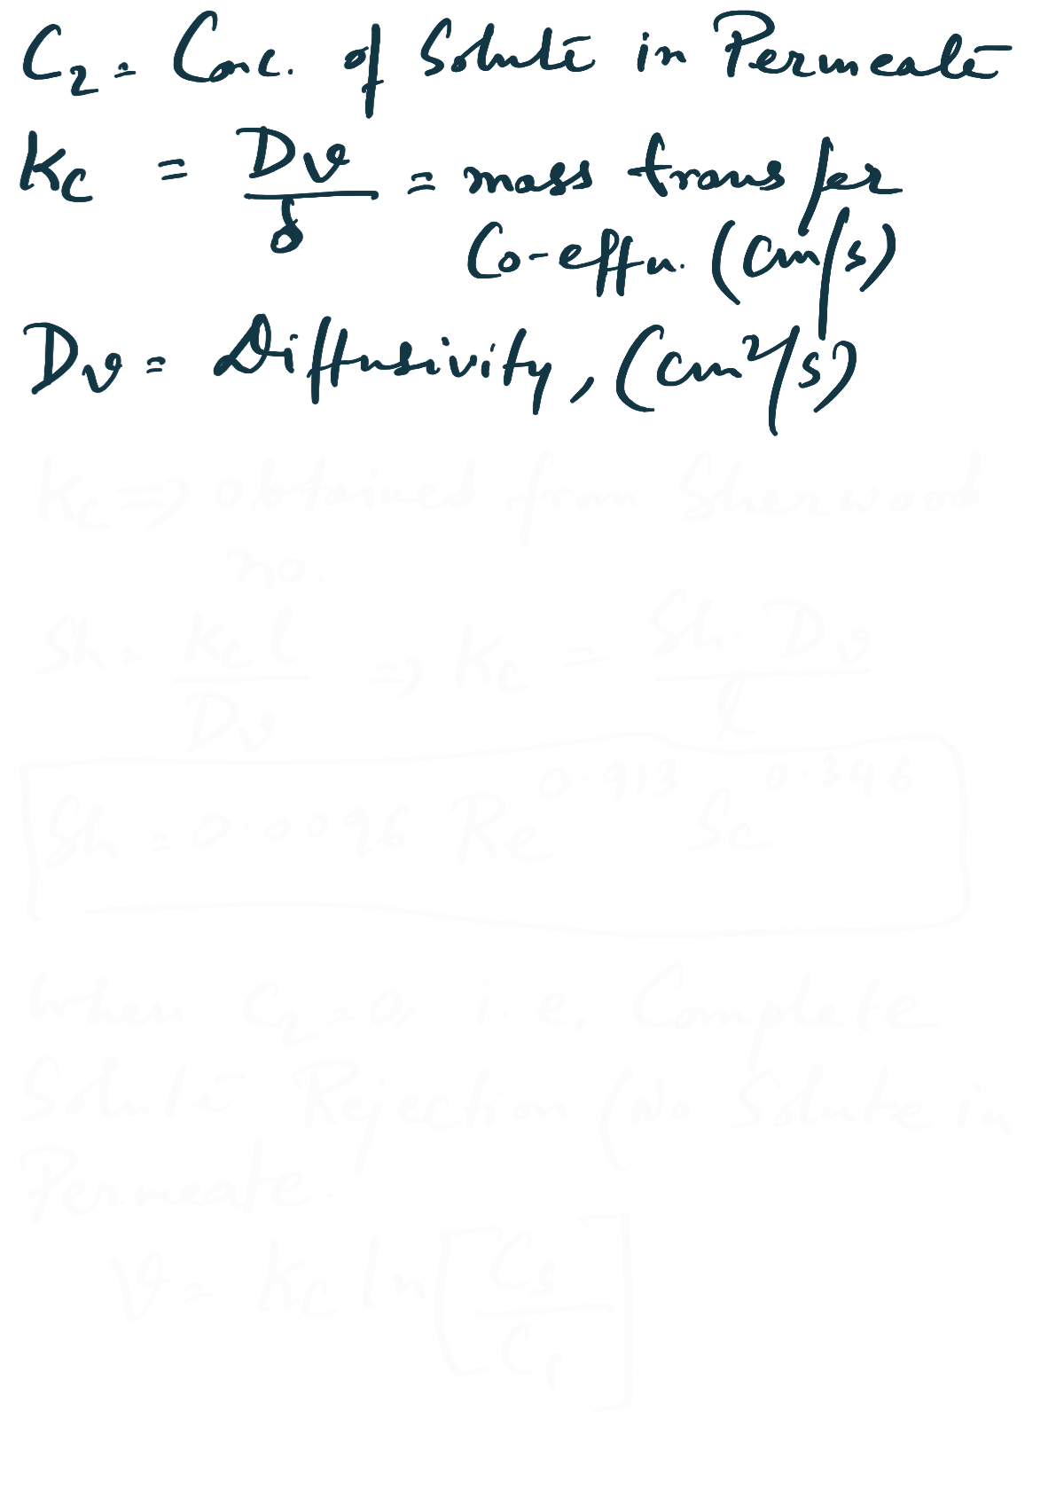

Slide 12
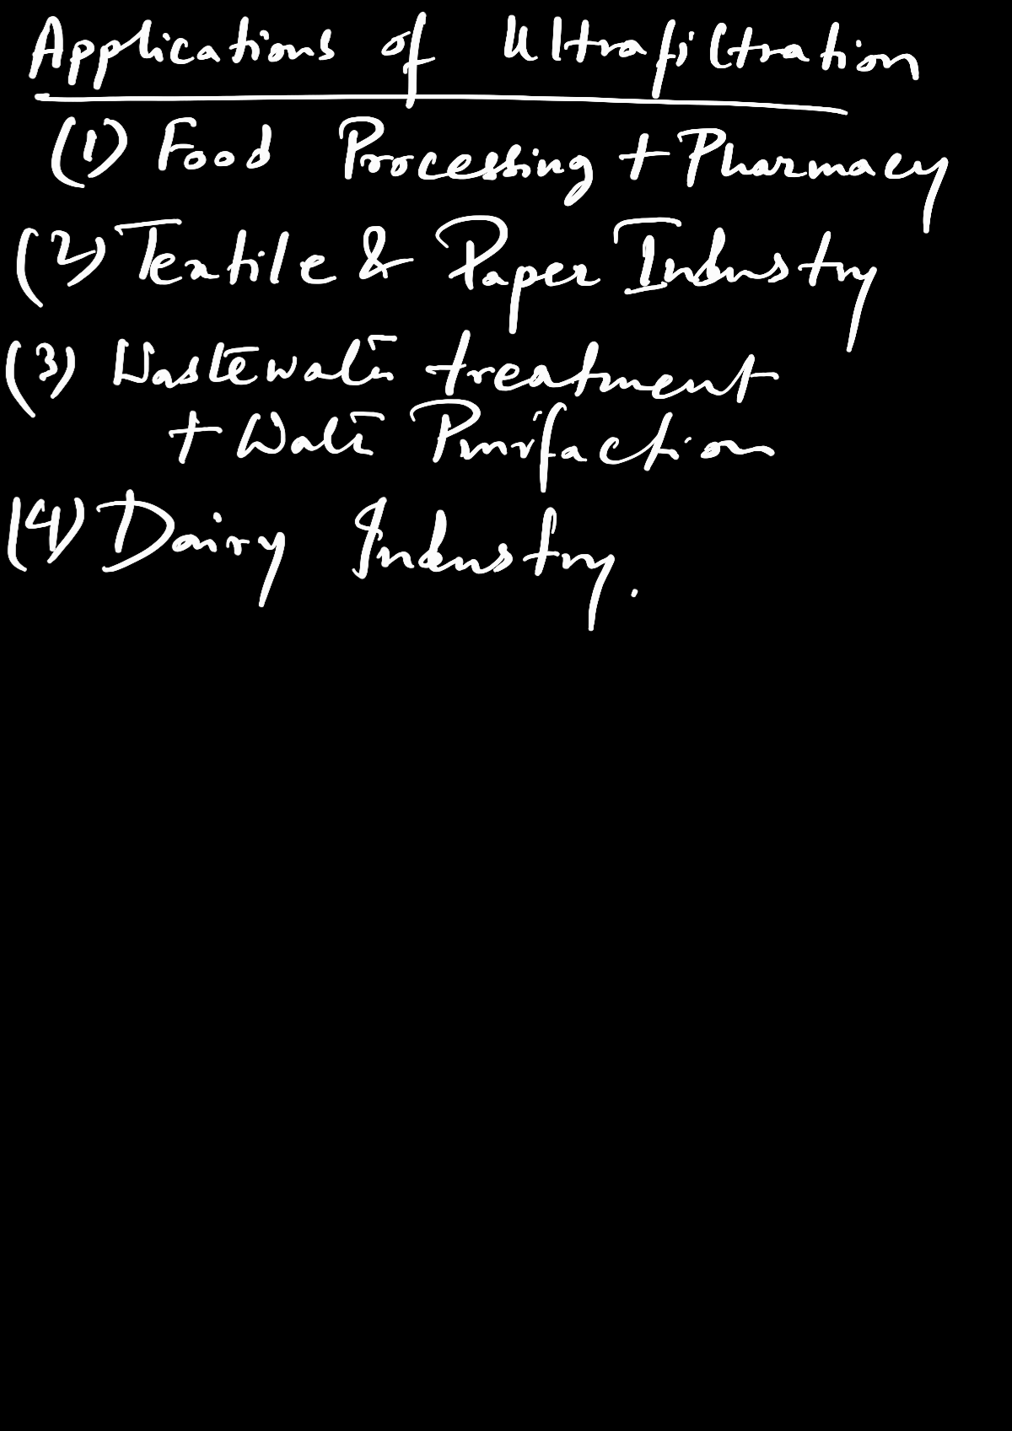

Slide 13
Gravity Sedimentation Processes
Reference: K. A. Gavhane. Unit Operations-I, [Fluid Flow And Mechanical Operations]

Slide 14
Gravity Sedimentation Processes
Sedimentation
The separation of solids from a suspension in a liquid by gravity settling
The gravity force is responsible for the motion of solids through the liquid.
Applications
Removal of solids liquid sewage wastes (waste-water treatment)
Removal of suspended impurities from water to be used for domestic and industrial purposes (water treatment)
Clarifier: A settler that removes virtually all the particles from a liquid
Classifier: A device that separates the solids into two fractions

Slide 15
Gravity Classifiers
Sink-and-float methods (Heavy-Fluid Separation)
A sink-and-float method uses a liquid sorting medium, the density of which is intermediate between that of the light material and that of the heavy.
Then the heavy particles settle through the medium, and the lighter one's float, and a separation is thus obtained.
Advantage:
The separation depends only on the difference in the densities of the two substances and is independent of the particle size.

Slide 16
Gravity Classifiers
Differential settling methods
Differential settling methods utilize the difference in terminal velocities that can exist between substances of different density.
The density of the medium is less than that of either substance.
Disadvantage
  since the mixture of materials to be separated covers a range of particle sizes, the larger, light particles settle at the same rate as the smaller, heavy ones and a mixed fraction is obtained.

Slide 17
Types of Settling
Free Settling
The fall of the particle in the gravitational field through a stationary fluid is not affected by the other particles and the wall of the container.
Process is possible only if the concentration of particulate solids in a suspension is very low.
Hindered Settling
The process where the fall of the particle in the gravitational field through a stationary fluid is affected by the other particles and the wall of the container.
Hindered settling is encountered when the concentration of solids in a suspension is large.
The settling velocity is considerably less than the terminal falling velocity under free settling condition.

Slide 18
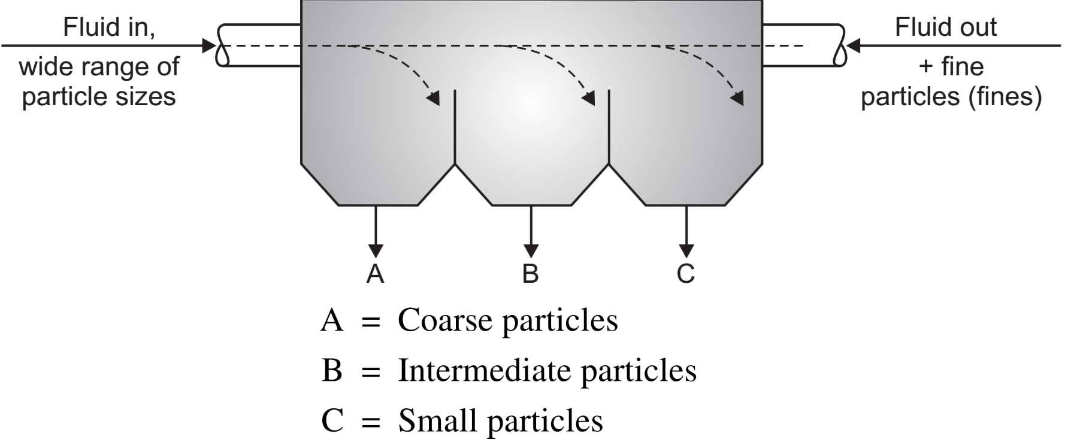
Gravity Settling Tank

Slide 19
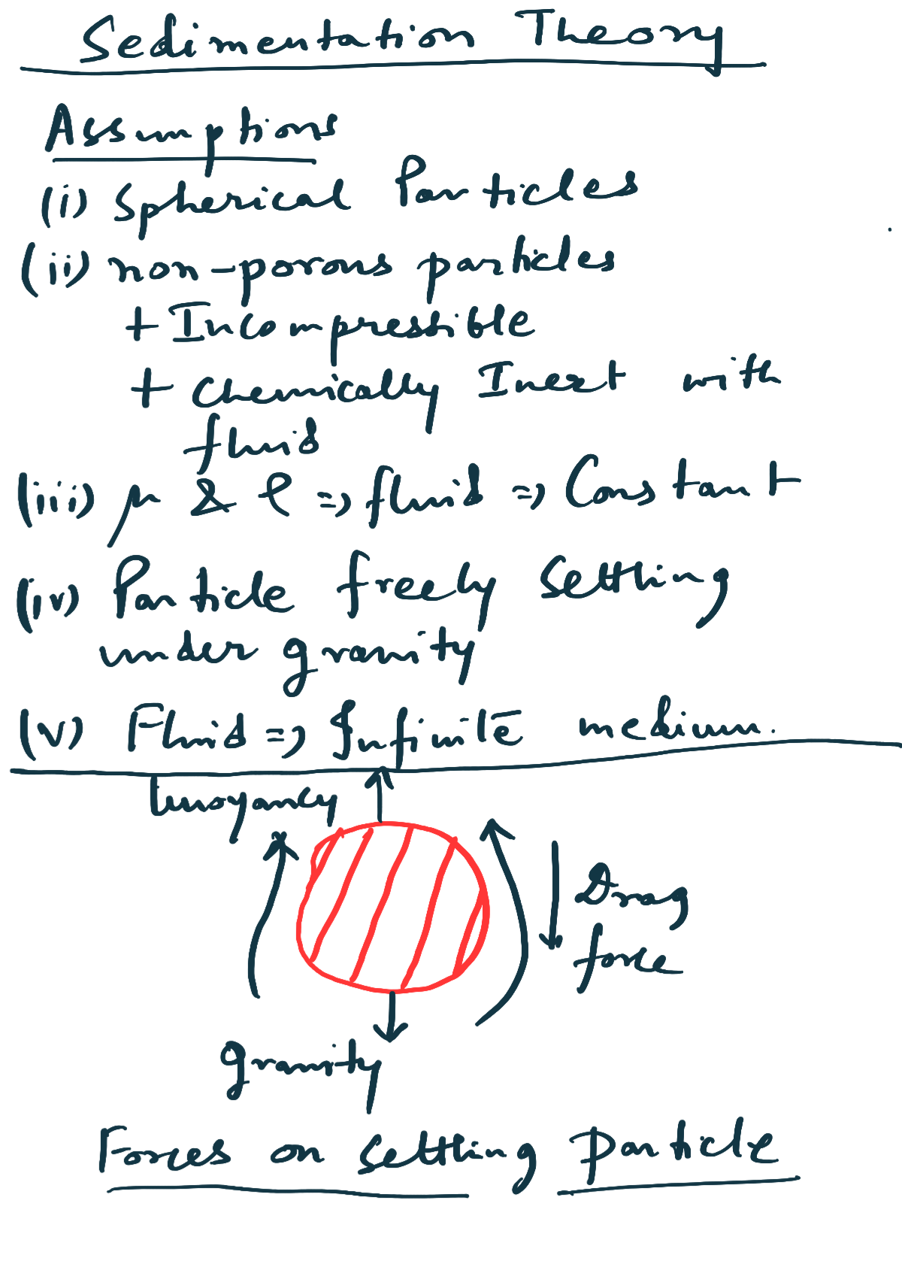

Slide 20
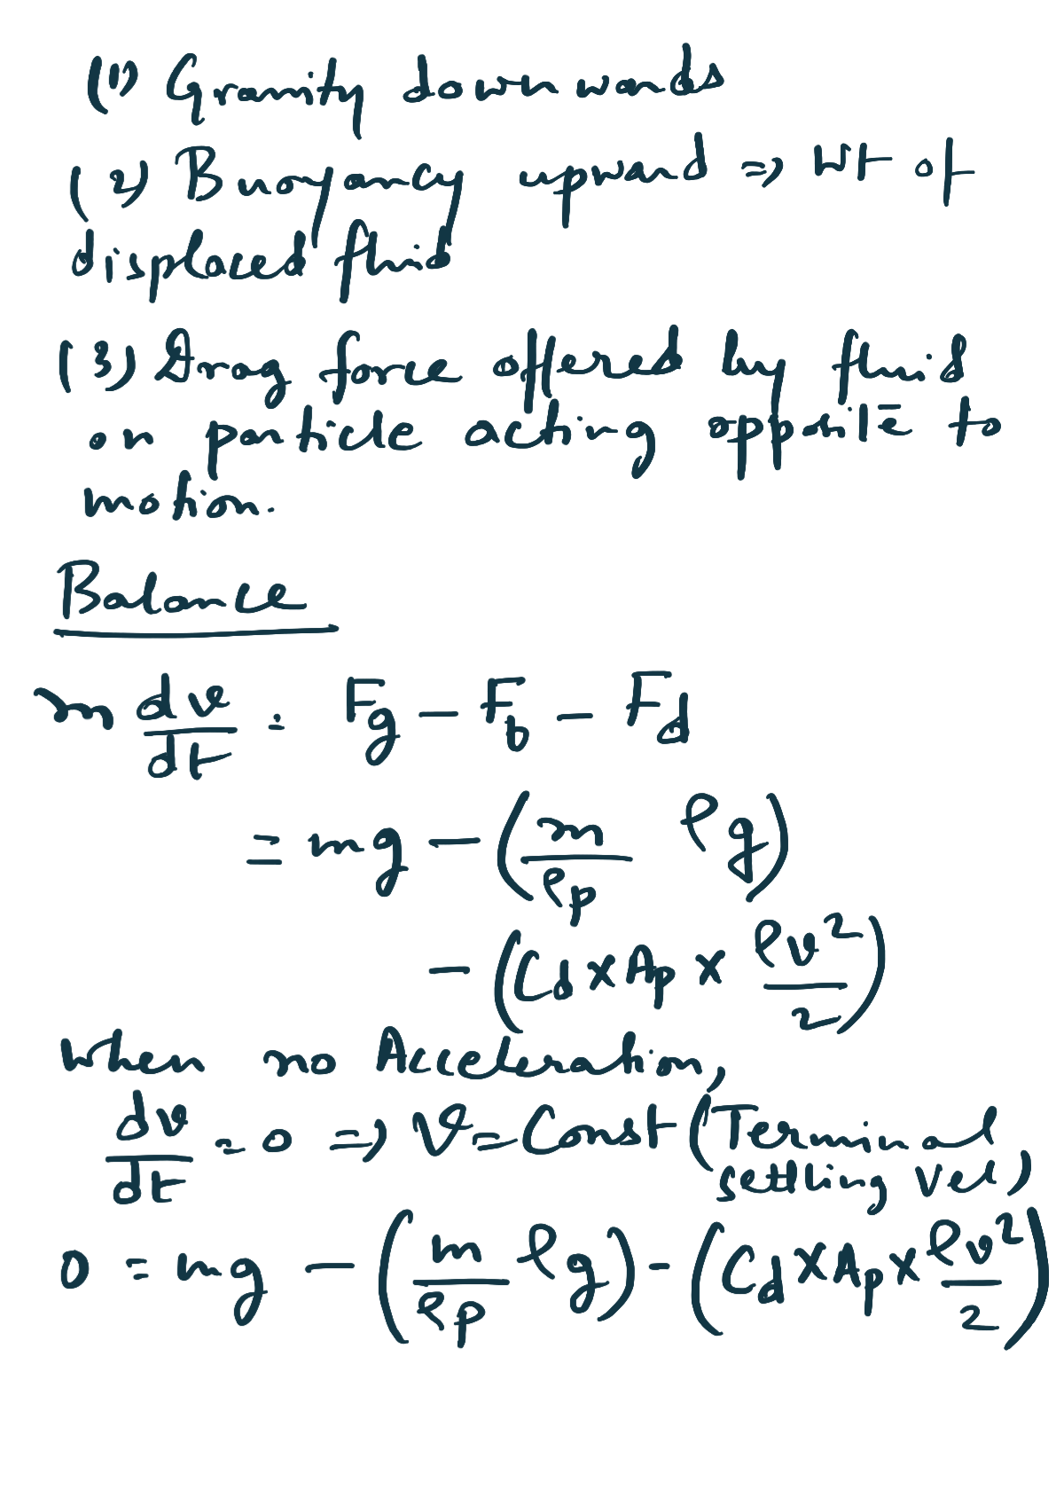

Slide 21
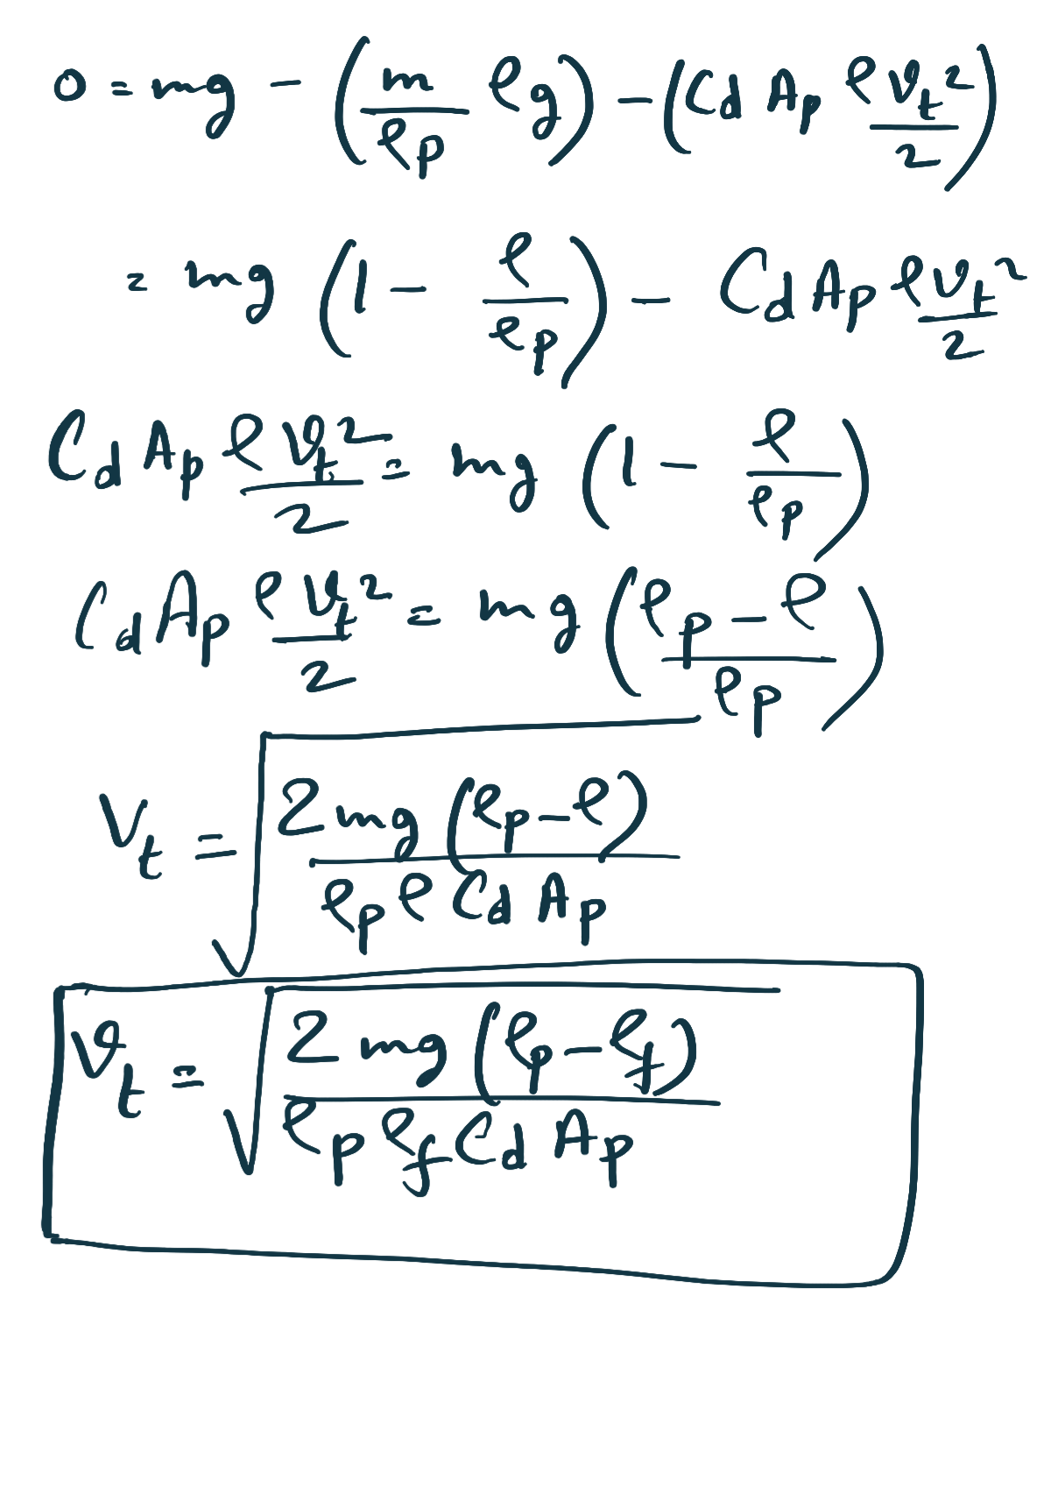

Slide 22
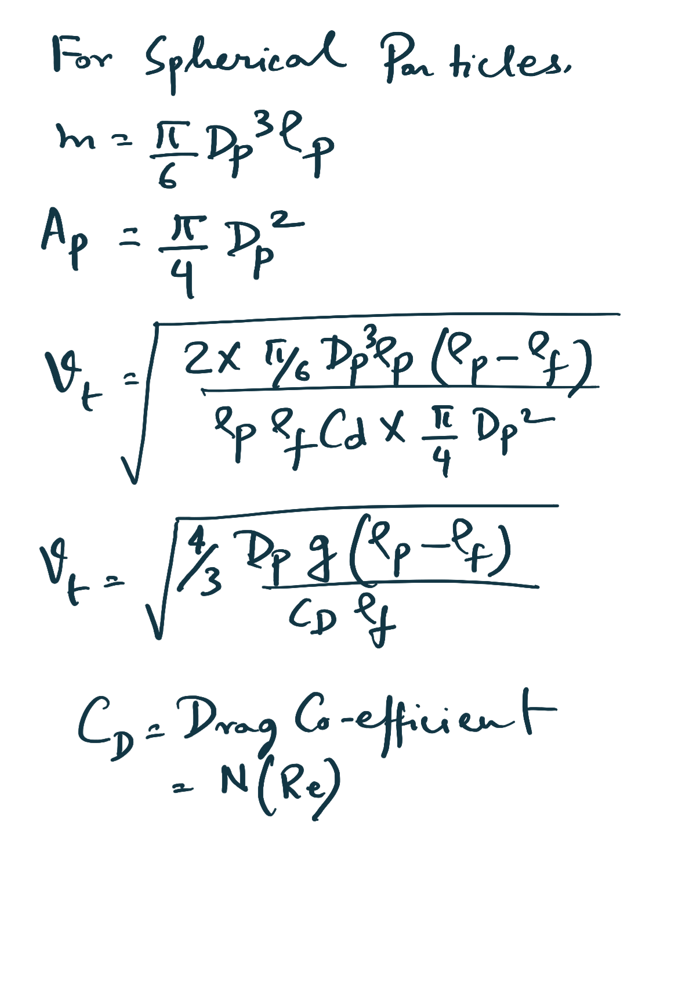

Slide 23
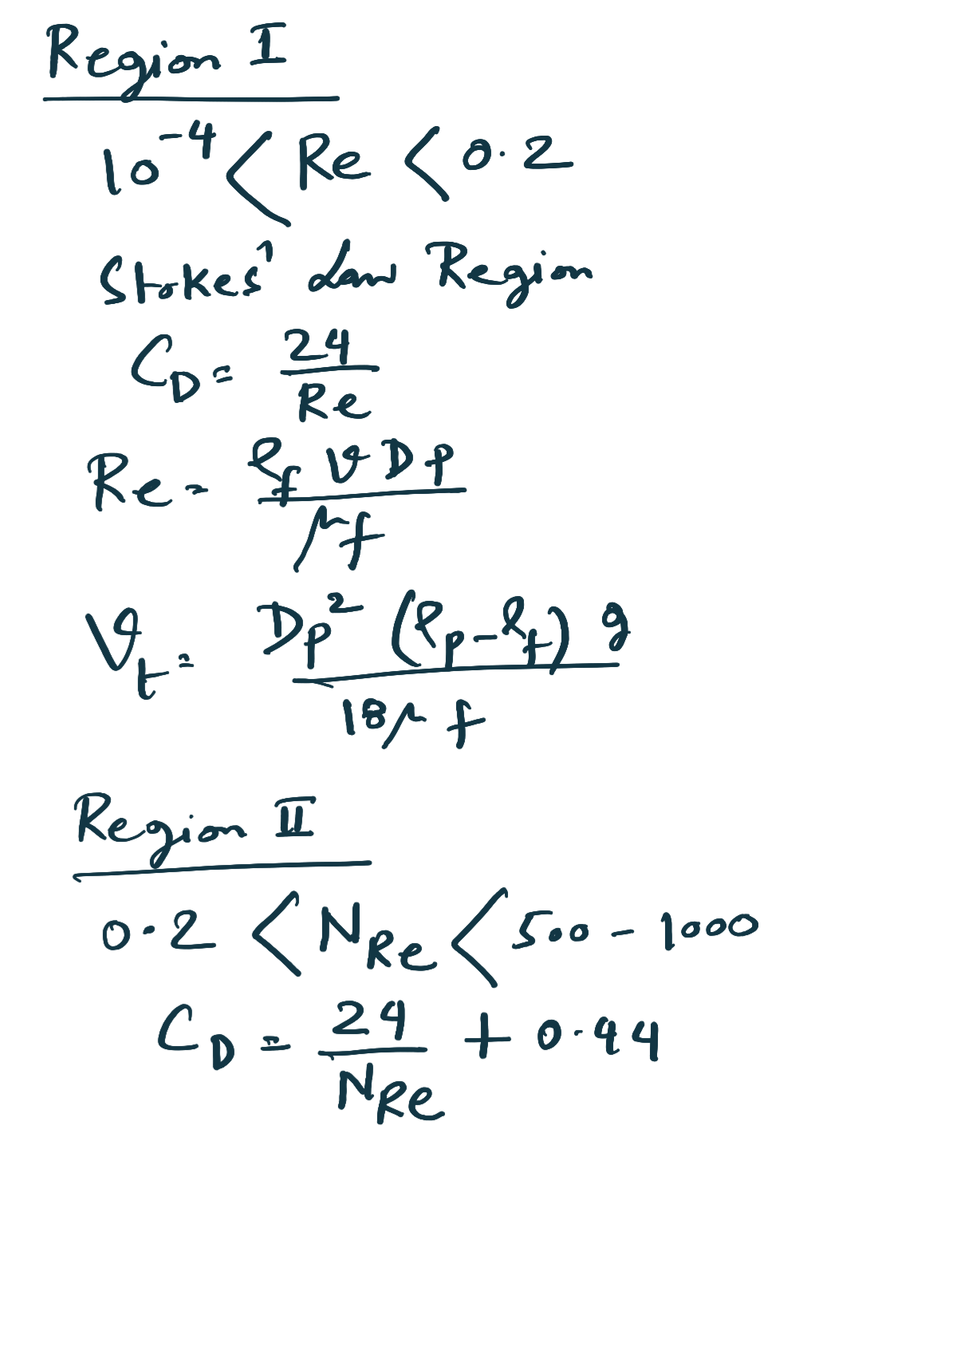

Slide 24
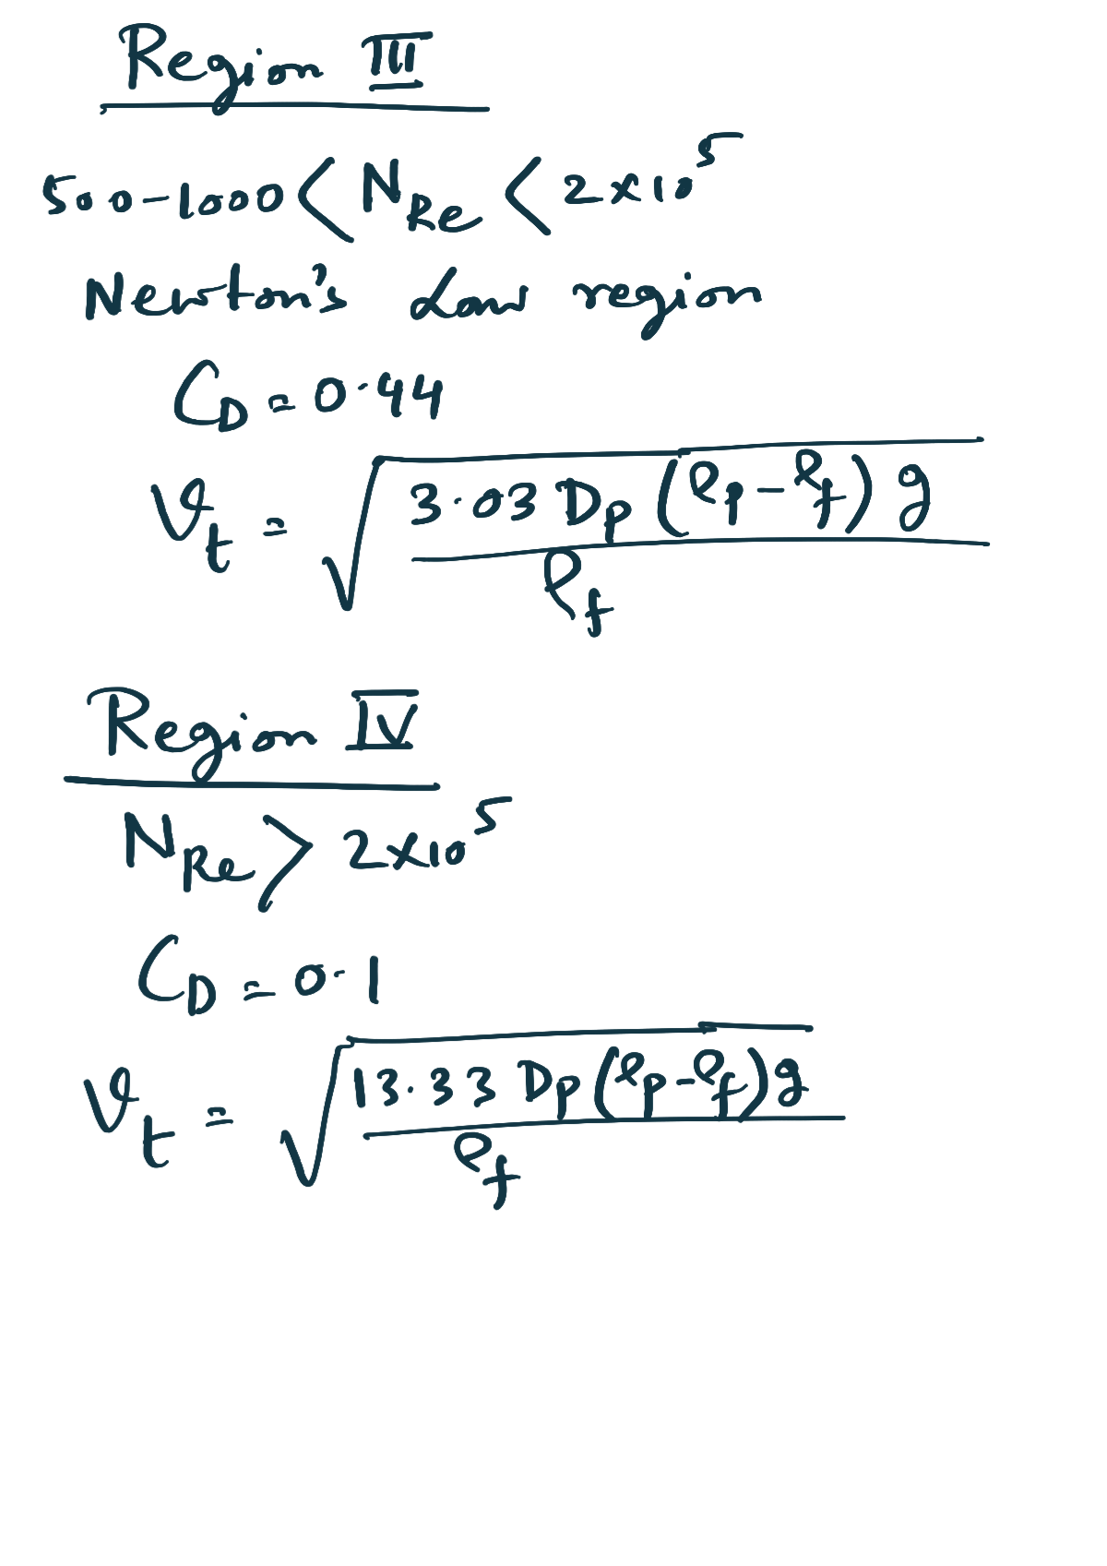

Slide 25
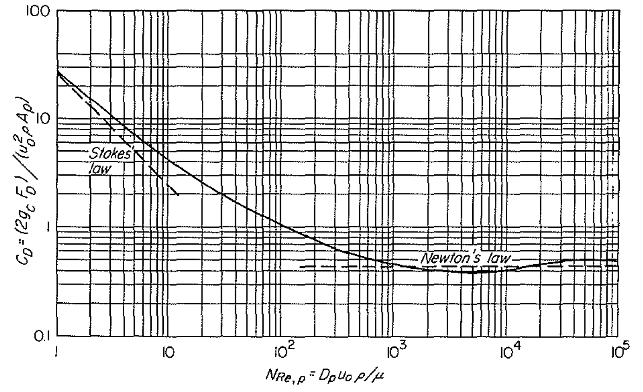
See chapter 7 page 168-170 for more discussion
Drag Coefficients versus Reynolds number

Slide 26
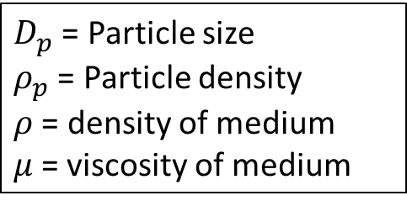
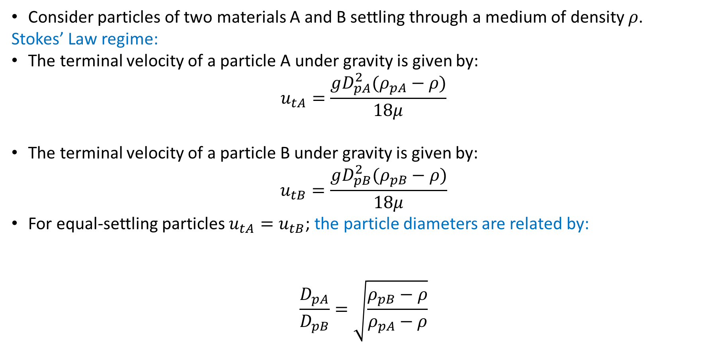
Differential settling methods
Consider particles of two materials A and B settling through a medium of density $ρ$.
Stokes’ Law regime:
The terminal velocity of a particle A under gravity is given by:
$$u_{tA}=\frac{gD_{pA}^{2}(ρ_{pA}−ρ)}{18μ}$$
The terminal velocity of a particle B under gravity is given by:
$$u_{tB}=\frac{gD_{pB}^{2}(ρ_{pB}−ρ)}{18μ}$$
For equal-settling particles $u_{tA}=u_{tB}$; the particle diameters are related by:
$$\frac{D_{pA}}{D_{pB}}=\sqrt{\frac{ρ_{pB}−ρ}{ρ_{pA}−ρ}}$$
$D_{p}$ = Particle size
$ρ_{p}$ = Particle density
$ρ$ = density of medium
$μ$= viscosity of medium

Slide 27
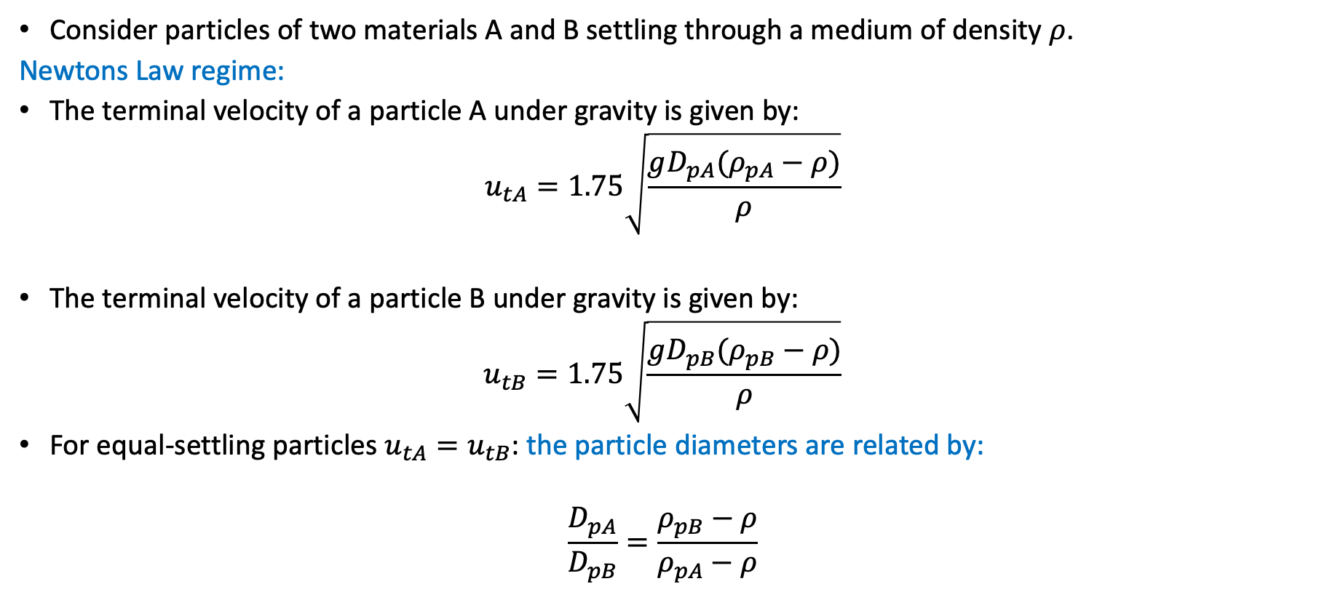
Differential settling methods
Consider particles of two materials A and B settling through a medium of density $ρ$.
Newtons Law regime:
The terminal velocity of a particle A under gravity is given by:
$$u_{tA}=1.75\sqrt{\frac{gD_{pA}(ρ_{pA}−ρ)}{ρ}}$$
The terminal velocity of a particle B under gravity is given by:
$$u_{tB}=1.75\sqrt{\frac{gD_{pB}(ρ_{pB}−ρ)}{ρ}}$$
For equal-settling particles $u_{tA}=u_{tB}$: the particle diameters are related by:
$$\frac{D_{pA}}{D_{pB}}=\frac{ρ_{pB}−ρ}{ρ_{pA}−ρ}$$
$D_{p}$ = Particle size
$ρ_{p}$ = Particle density
$ρ$ = density of medium
$μ$= viscosity of medium

Slide 28
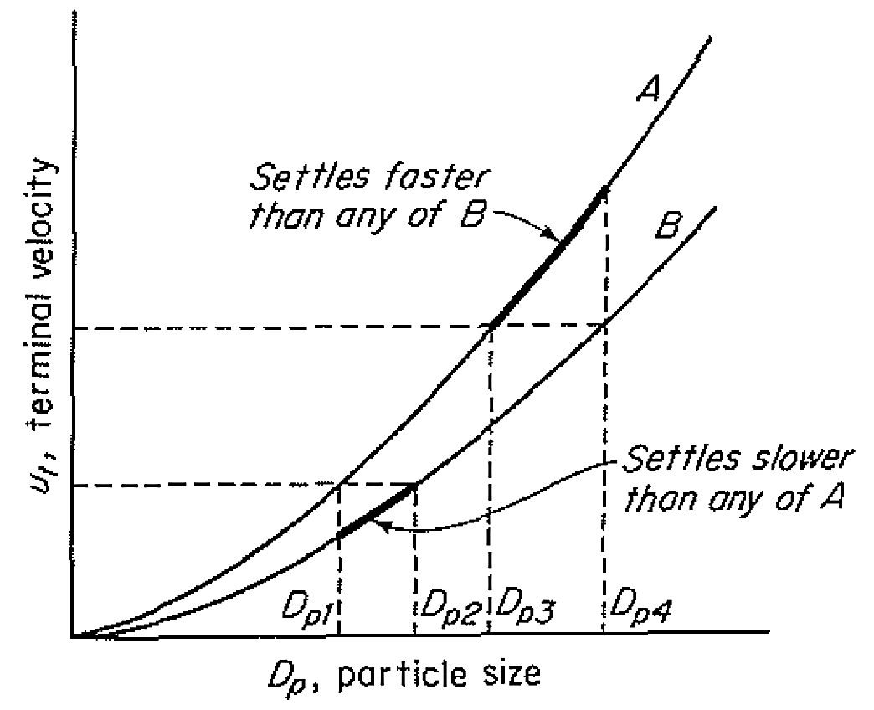
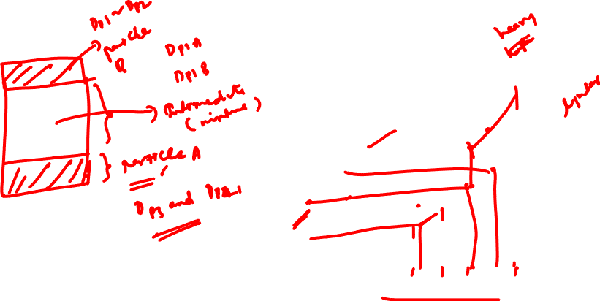
Equal Settling Particles
Terminal velocity versus Particle diameter in the intermediate regime between Stokes’ Law and Newton’s Law

Slide 29
Clarifier and Thickeners
Gravity separation under hindered settling conditions is often used to convert a dilute slurry of fine particles into a clarified liquid and a concentrated suspension.
This process is carried out in large open tanks called thickeners or clarifiers.
The clarified liquid is free or nearly free of suspended particles, and it may be reused as process water or discharged as waste.

Slide 30
Clarifier and Thickeners
Flocculation
If the solids in a suspension are mainly individual particles only a few micrometers in diameter, the gravity settling rate would be very low and perhaps too low for practical operation.
In many fine suspensions, the particles form agglomerates or clusters of particles that settle at reasonable rates.
Agglomeration is sometimes promoted by adding flocculating agents
  strong electrolytes, which reduce the repulsive forces between the charged particles, or polymeric flocculants that may be cationic, anionic, or nonionic in character.
Flocculation is also carried out by adding inexpensive materials
  such as lime, alumina, or sodium silicate, which form loose agglomerates that carry fines down with them.

Slide 31
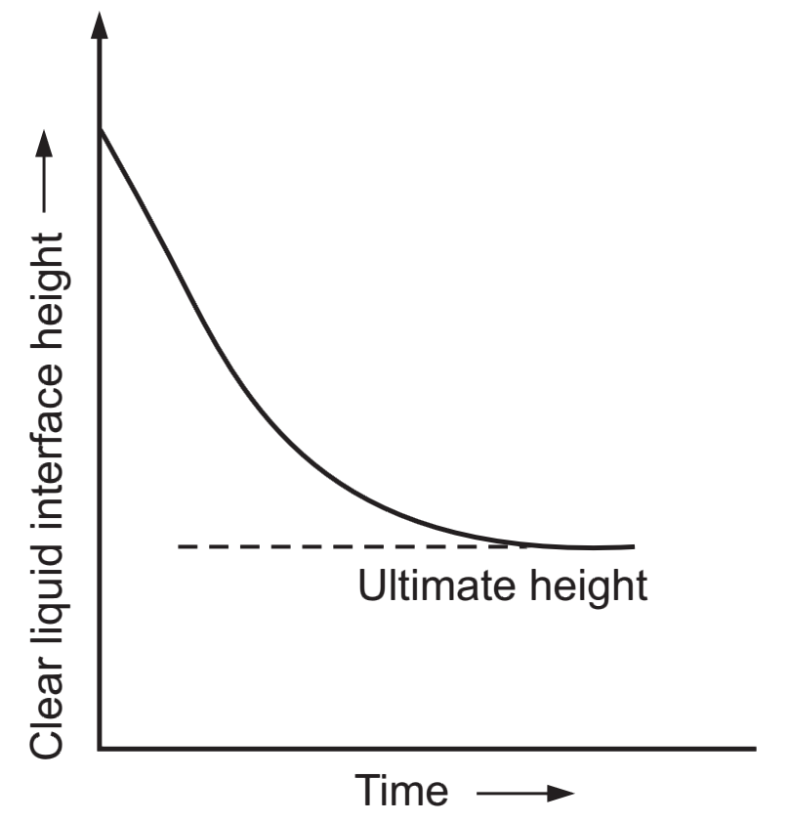
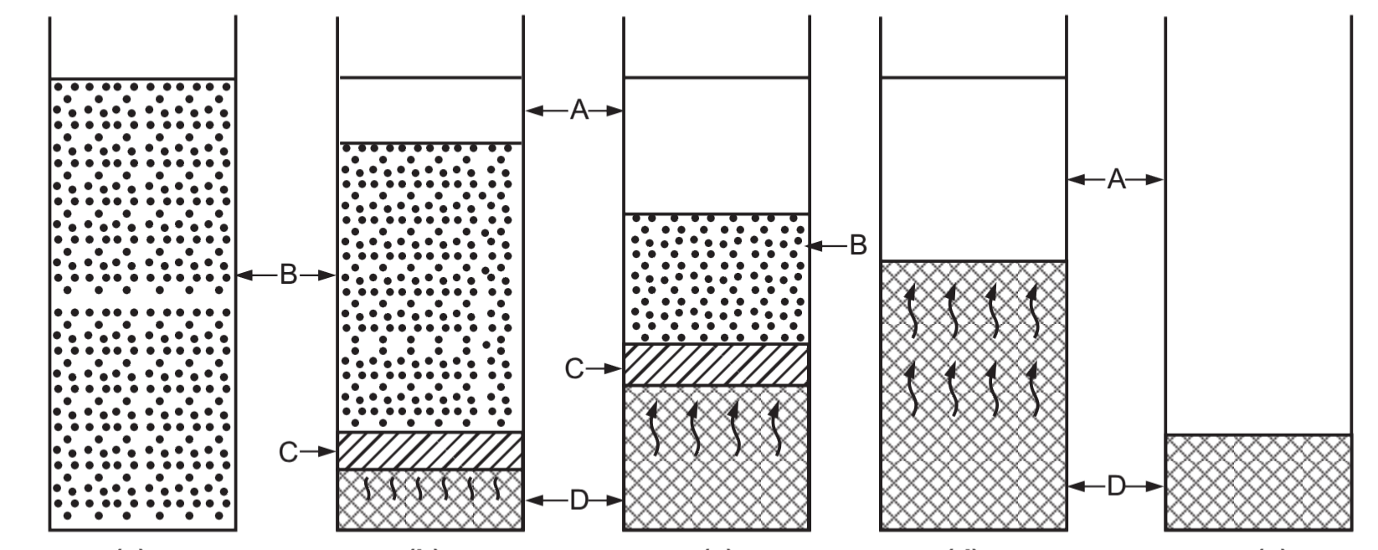
Batch Sedimentation
Solids uniformly distributed liquid
time

Slide 32
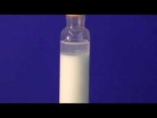
Batch Sedimentation

Slide 33
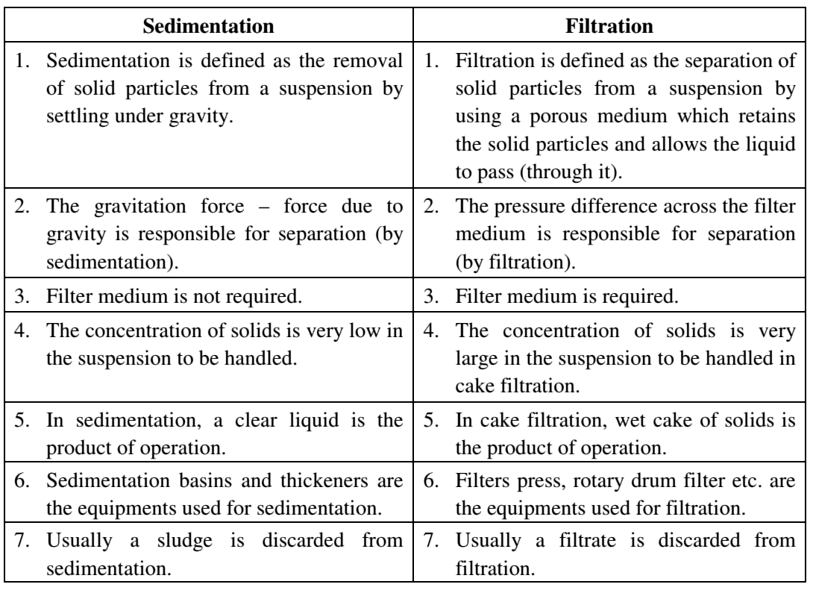
Sedimentation Versus Filtration

Slide 34
References
Smith, J., Harriott, P., McCabe, W. (2005). Unit Operations of Chemical Engineering. Colombia: McGraw-Hill Education.
Swain, A. K., Patra, H., & Roy, G. K. (2011). Mechanical operations. Tata McGraw Hill.

